Slide 1
Physical Education
Components of Health-Related Fitness

Slide 2
Learning Objectives
By the end of this lesson pupils should:
Know & Understand the components
of health-related exercise
Be able to relate these components
to different physical activities

Slide 3
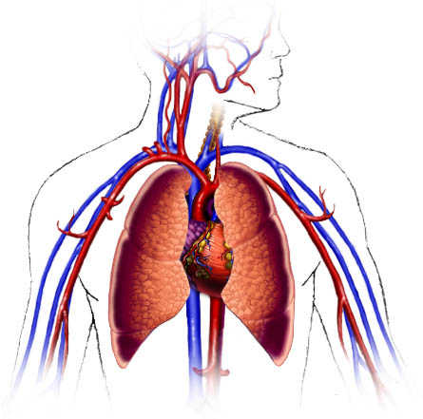
Cardiovascular Fitness
The ability to exercise the entire body for long periods of time

Slide 4
Cardiovascular Fitness
Concerned with the fitness of the
heart and the lungs
It can be improved by training
Required to allow long hard matches
to be played (football, netball, etc.)
It is crucial for developing other types of
fitness

Slide 5
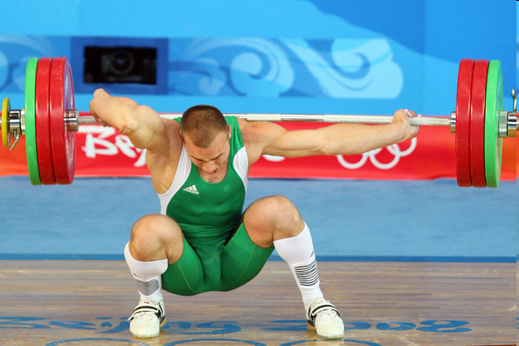
Muscular Strength
The amount of force a muscle can exert against a resistance

Slide 6
Muscular Strength
Enables the lifting of very heavy weights
Developed by lifting heavy weights with few
repetitions or high-intensity strength work
Required when exerting a lot of effort in a
short burst (weightlifting, rugby scrum, etc.)
Associated with steroids

Slide 7
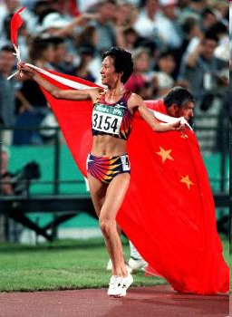
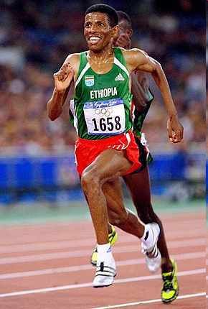
Muscular Endurance
The ability to use the voluntary muscles many times without getting tired

Slide 8
Muscular Endurance
Enables muscles to be exercised
repeatedly without getting tired
Necessary for many sports and physical
activities
It is important for general fitness, everyday
life
Daily chores are examples of this also

Slide 9
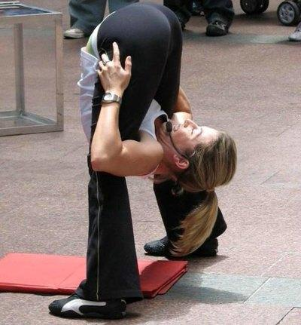
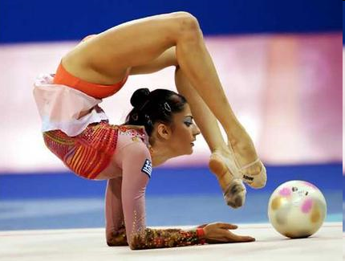
Flexibility
The range of movement possible at a joint

Slide 10
Flexibility
Often neglected and taken for granted
Demonstrated in gymnastics, badminton, etc.
Yoga can help improve flexibility

Slide 11
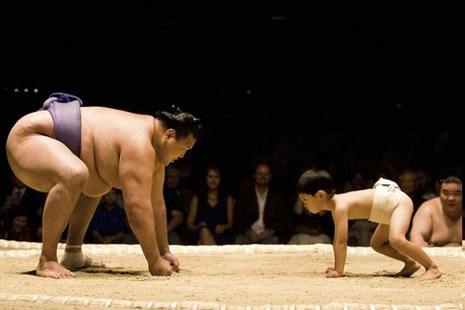
Body Composition
The percentage of body weight that is fat, muscle and bone

Slide 12
Body Composition
Influenced by genetics
But can be improved to a degree
through diet and exercise
Body shape can be enhance through
playing sport

Slide 13
Body Mass Index
The most common and easiest way to get an idea of your body composition is by calculating your body mass index (BMI).
This method is used by the NHS and often by insurance companies to see if applicants for life insurance policies are a safe risk.

Slide 14
How To Measure BMI
Calculate height (using tape measure)
Calculate weight (using scales)
Find your place on the BMI Chart
Is this an accurate reading?

Slide 15
Learning Objectives (Revisited)
By the end of this lesson pupils should:
Define the terms health, fitness, exercise &
performance
Understand the components of health-related
exercise
Be able to relate these components to
different physical activities

